Slide 1
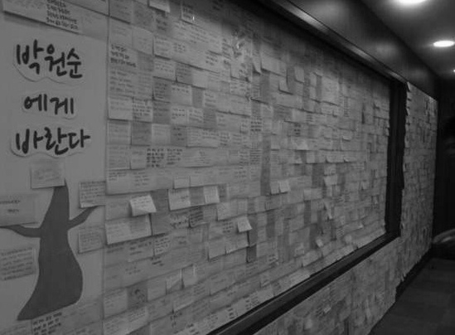
Beyond “Creativity”
towards “Hope”
| Vision and Creativity Promotion Division | 2012

Slide 2
Index
I. Launch of the Creative Administration
II. New Administrative Paradigm - Creative Administration
Ⅲ. Seoul is Changing through Creative Administration

Slide 3
I. Launch of the Creative Administration
1. Rapid Changes in Administrative Environment
2. Seoul Now
3. Why Creative?

Slide 4
1. Rapid Changes in Administrative Environment
World Now… Age of Limitless Competition
Competition that is uncertain, without boundaries and changes rapidly
Only the world's best will survive
Competition from Cross-national to Cross-city
Urban competitiveness driving national competitiveness
Competition landscape expanding from cross-metropolis to
cross-megalopolis

Slide 5
2. Seoul Now
Seoul’s External Status… Global Scale
Population (8th) : 10.53 million
Subway (4th) : 9 lines covering 316.8km in total
Urban IT Level (1st) : Levels of computers, Internet and e-Government
Conventions (9th) : Holding 125 Int’l conferences per year
※ One of the world's top 10 cities having hosted both the Olympics (1988)
and the World Cup (2002)

Slide 6
2. Seoul Now
In the 21st Century Global Mega-competition Environment, Seoul will …
Act as“a chief wild goose”as Korea's capital
Compete with global cities and lead Korea's development
⇒ The existing focus on working hard & emulating advanced global
cities is not enough.
⇒ A new paradigm is required for new ideas and new challenges
based on “creativity” and “imagination.”
Notes:
.

Slide 7
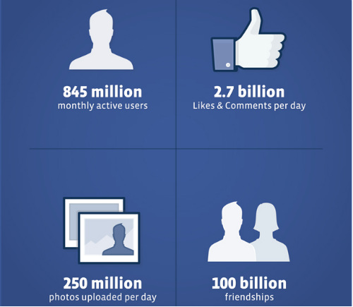
3. Why Creative?
Facebook – The world’s most innovative company

Slide 8
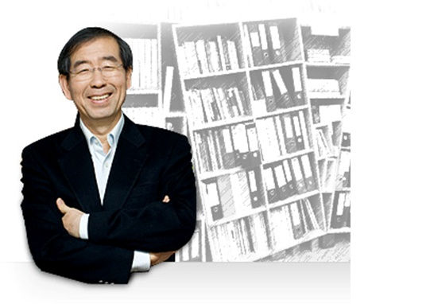
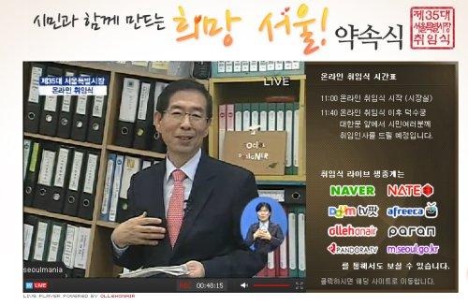
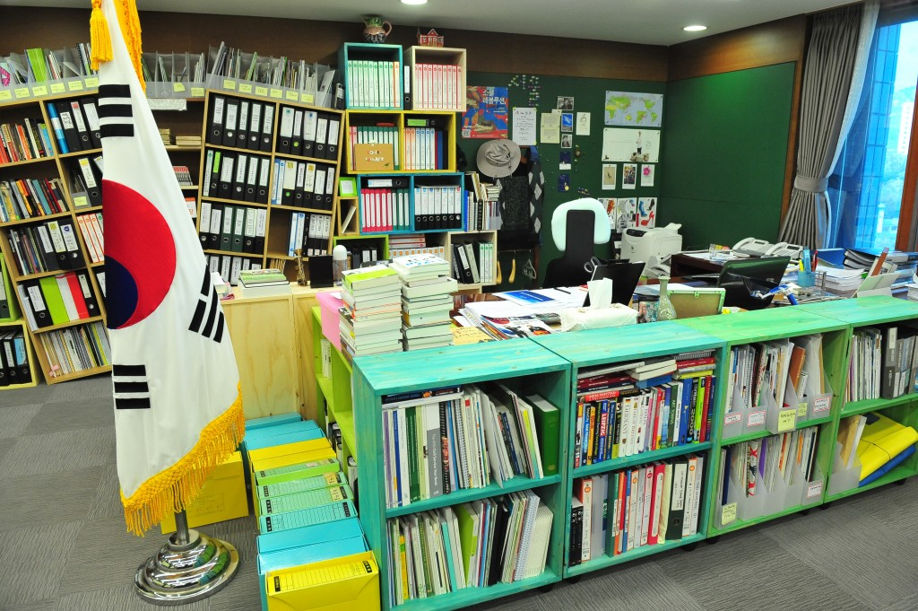
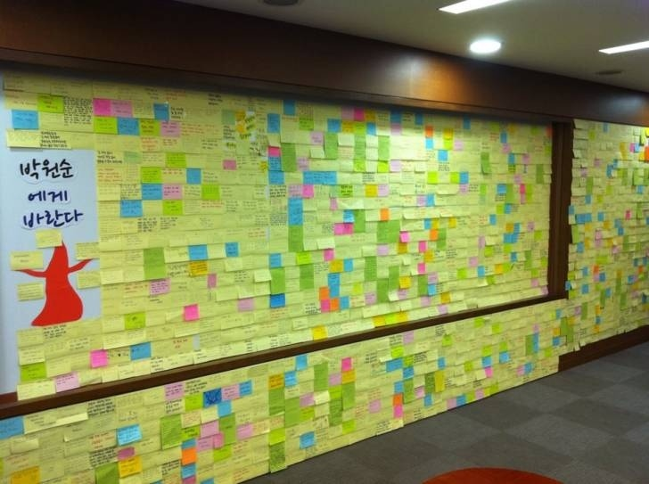
Park Won Soon – A Maestro of imagination & creativity
Online Inauguration
Mayor's
Office

Slide 9
Voice of citizens : We suggest to Seoul
Please create an environment where young people can marry without worrying about setting up home or paying unaffordable rents.
College tuition fees are too expensive.
Parents have to work hard and are very concerned.
What solutions do you have?
“I was informed of the expiry of my employment agreement.” Employment instability is a serious problem.
Mr. Mayor, please do something to stabilize jobs. My life is too hard.
Suggestion to the Mayor
I suggest that you create a ‘welfare Seoul’ where elderly people don’t have to collect waste paper for their livelihood or lead such a hard daily life.
My husband and I work together to earn our livelihood, so we are eligible for a first-priority ticket, but we have to be on the waiting list with priority no. 150.
I may miss the opportunity to use a national or public childcare house, and may send our child to a kindergarten.
If we had the opportunity, I could take my child from the care of my husband’s home, and make him stay with us.
However, I am frustrated with the current situation.
I suggest that you create a Seoul where mothers and their children can stay together, and where working moms can work with fun.
Policy workshop (December 12, 2011)

Slide 10
II. New Administrative Paradigm
– Creative Administration
1. Concept and Definition
2. Basics for Creative Administration: Establishing “Creative Infrastructure”
3. Creative Proposal System
4. Creative Implementation System
5. Evaluation & Incentive System
6. Creating a Creative Organizational Culture

Slide 11
1. Concept and Definition
Definition of
"Creative Administration"
Nurturing an innovative learning environment in government and encouraging voluntary and continuous creative proposals from all city government officials in order to
increase the happiness and quality-of-life of citizens.
Basic Philosophy
Put ourselves in citizens' shoes

Slide 12
1. Concept and Definition
Road Map for
Creative Administration
Intensification & Spreading
Internalizing and spreading a creative organizational culture,
Establishing a creativity model and spreading it at home and abroad
Establishment & Advancement
Introduction &
Boom up
Modulating by materializing creative administration
Raising civic awareness on creative administration
Setting up basic infrastructure & overall systems
Establishing the basis for a creative organizational culture

Slide 13
2. Establishing Creative Infrastructure
Prior to Starting
"Creative Administration"
Out-of-date infrastructure cannot successfully
drive Creative Administration
Hierarchy
▼
Work & Achievement
In-service Education
▼
Fostering Creative Talents
Post
Investigation
▼
Praise for Creative Failures
Supplier-
oriented
▼
Citizens First
New Personnel System
New Education System
New Audit System
New Civic Appeals System

Slide 14
2. Establishing Creative Infrastructure
A New Personnel System
Previous
- Hierarchy-based personnel management, poor conditions
to allow “creativity” and “imagination” to be applied to
administration and no ground for creative talents
- A lack of performance-based reward systems – weak motivation
Creating a Competition-based Work Atmosphere - Performance-reward linkage, creating creative performance
and stronger capacity
- Faster promotion possible for competent and high achievers
- Systems to reward and motivate creative talents

Slide 15
2. Establishing Creative Infrastructure
A New Audit System
The existing rule-of-law-based and past-oriented
audits hamper creativity development
Creating an organization atmosphere not afraid of failure
- Performance-based audits without disadvantages to personnel
even in the case of weak performance following try-outs in
citizen services

Slide 16
2. Establishing Creative Infrastructure
A New Education System
The existing education system is weak in
recharging, developing and supporting creativity
- passive-oriented education, individual capacity-building education
Realigning education
system toward a continuous
learning system for
creativity development
- Intensifying u-Learning-oriented
learning support systems
- Adopting “U-Knowledge Tour”
enabling learning anytime, anywhere via mobile (1,700 contents developed)

Slide 17
2. Establishing Creative Infrastructure
A New Civic Appeals System
Previously
- Via Phone : Busy line in Seoul Metropolitan Government
Not available. Please try again
- Via Visit: Not knowing which department to go to
Faster, more convenient and higher quality
service focused on customer citizens on the
demand side - Via Phone: Only a single call to 120 Dasan Call Center - Via Visit: Only a single visit [One-Stop] to Dasan Plaza
Call Response Rate within 15 Second : 92.5%

Slide 18
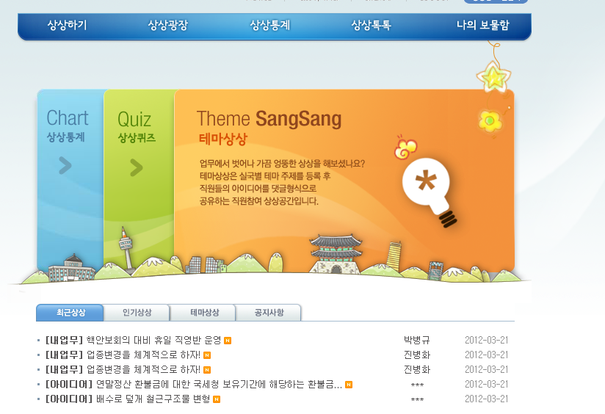
3. Creativity Proposal System
Public servants’Idea Bank
"Imagination Bank"
Function : A window for
SMG employees’idea proposals
Launch Date : July 28,2006
Incentives
- Cyber money for each activities (1p = 10 Won)
creative proposal : 20p ~ 20,000p
implementation : 5,000p ~ 20,000p

Slide 19
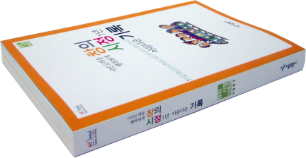
3. Creativity Proposal System
Operational Results
"Imagination Bank"
252,800 Creativity Proposals
(Increase of idea proposals by 100 times compared to the pre-Imagination Bank)
124cases /day on average,
3,700cases/month on average

Slide 20
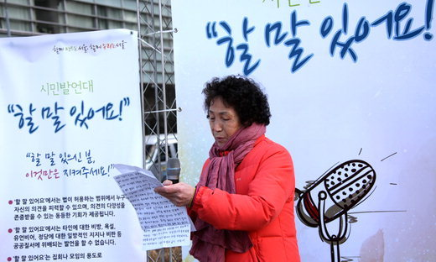
3. Creativity Proposal System
Major Ideas from “Imagination Bank”
Speaker's Conner at Cheonggye Square
Tourist Information Interpreter

Slide 21
3. Creativity Proposal System
Implementing Citizens’ Ideas into Policymaking
After – “ Oasis for 10 million Imagination”
Open discussions over the Internet
“Implementation Discussion” offline where citizens
and policymakers have face-to-face idea discussions
A real-time interactive communication channel with citizens
Year | Total | 2006 | 2007 | 2008 | 2009 | 2010 | 2011
Proposal | 136,379 | 2,599 | 7,729 | 9,067 | 36,289 | 64,798 | 15,897
Before – Existing Proposal System
A mere one-on-one response by the department in charge of citizen proposals

Slide 22
3. Creativity Proposal System
Upgrade of Oasis for 10million Imagination
… With More Citizens, More Easily, More Fun
Wikipedia-like way : Adding new ideas to original proposal
Opening Mobile Webpage , Linking with SNS
Citizen Poll : Selecting good proposals for Good Policy
Contest
Good Policy Contest : Awarding TOP3 proposal through
discussing and pushing-button voting
Organizing Citizen Scout, Citizen press corps

Slide 23
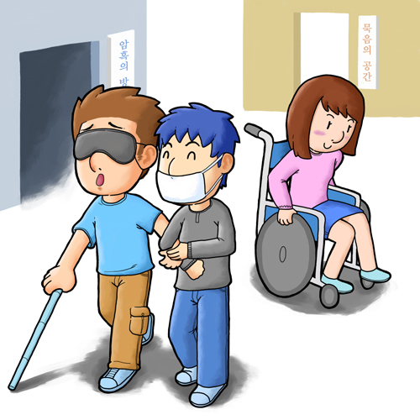
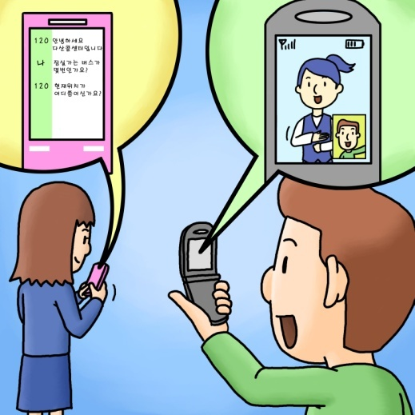
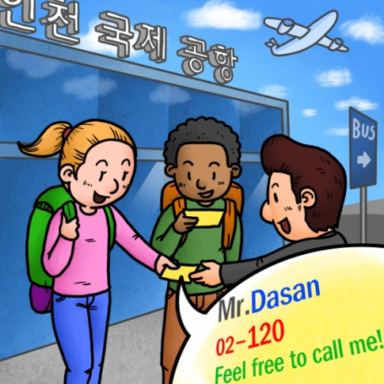
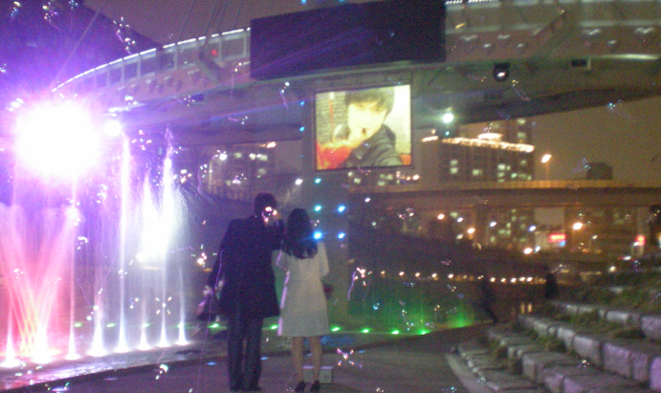
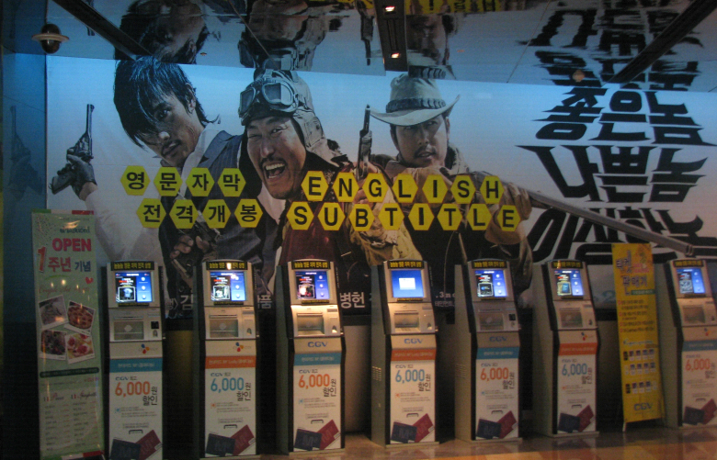
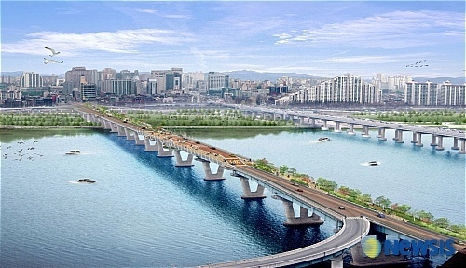
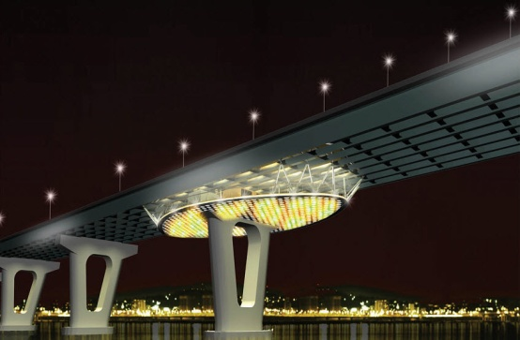
3. Creativity Proposal System
Major Ideas from “Oasis for 10 million Imaginations”
Disability-experiencing Zone
Sign Language Service
Pedestrian-only Gwangjin Bridge
Wall of Proposal
English Subtitles in Korean Films

Slide 24
4. Creativity Implementation System
Positive Competition and Cooperative Scheme through Networking Among Working Groups
Creative Administration
Creative Management
Creative Administration
25 Autonomous Districts
Investment & Affiliated Institutions

Slide 25
5. Evaluation & Incentive System – Creative Administration’s Motivation and Facilitation
Creative Activity Evaluation on Offices, Bureaus and Headquarters
Analyzing creative activity levels and proposing
directions among each group lead to favorable competition
where heads of offices, bureaus and headquarters
are accountable - Creativity Rewards after evaluation results
Creative
Activity
(45%)
Major Task
(45%)
Comprehensive Evaluation
(100%)
Group Head’s
constant record-keeping
(10%)

Slide 26
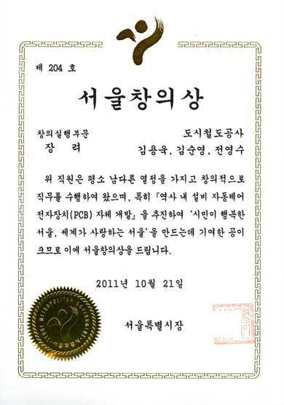
5. Evaluation Incentive System
Performance Evaluation for Individuals or Projects
5 main sectors, reward money, performance points and
opportunities to experience global policies abroad
Seoul Creativity Award
Creativity Proposal
Creativity Implementation
Creativity Policies
Budget Reduction
Knowledge Management
• Excellent proposals from Imagination Bank and Imagination Oasis
• Excellent proposals from autonomous districts and investment & affiliated institutions
• Excellent implementation cases from Imagination Bank and Imagination Oasis
• Excellent projects with outstanding performance among major metropolitan administration projects
• Excellent cases on budget reduction and higher tax revenues
• Cases on reporting budget waste (by citizens)
• Excellent research performance of Creativity Knowledge Club
• Excellent papers on metropolitan administration
• Excellent Cases of SMG employees’ academic researches

Slide 27
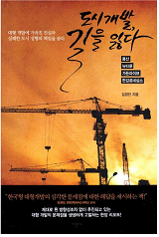
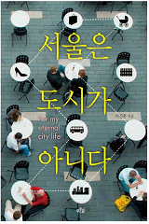
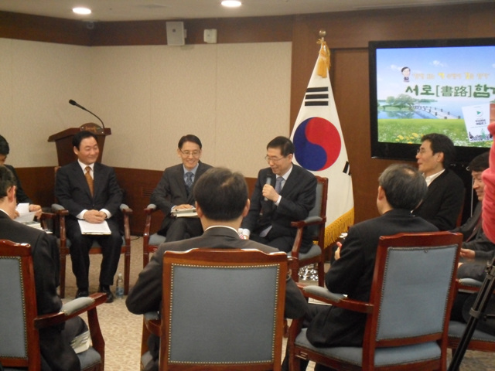
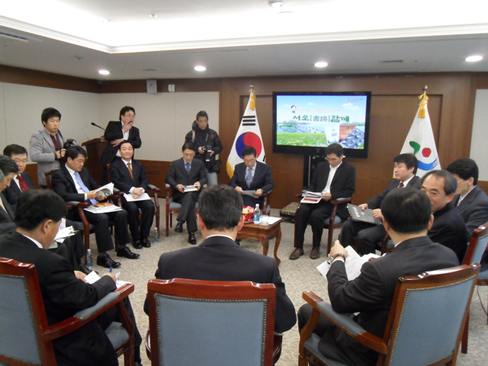
6. Creating a Creative Organizational Culture
Hold a book meeting
attended by mayor & executives.
Expressing and sharing various opinions!

Slide 28
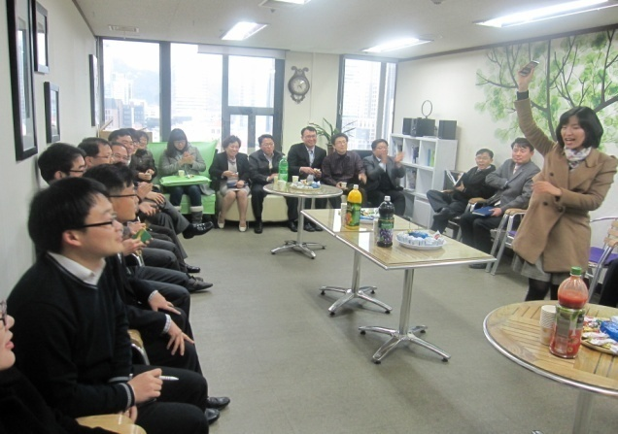
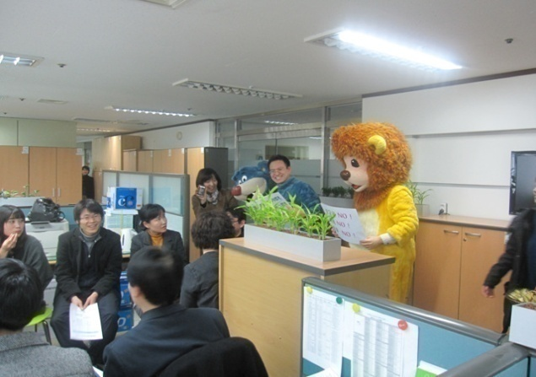
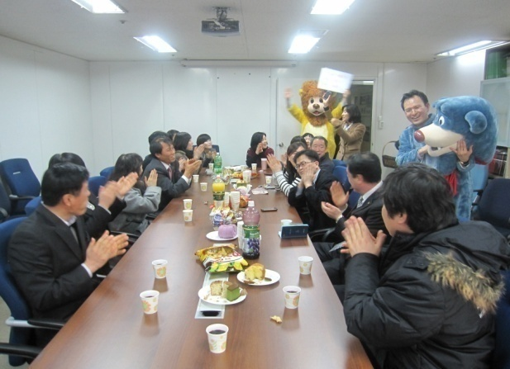
6. Creating a Creative Organizational Culture
To Create a Passionate Organizational Culture :
“The Day of Communication”
Operating The Day of Communication : Every Wednesday
- The time shared by members with natural and sincere conversation
- Making members more cooperative and enhancing mutual understanding by sharing difficulties and hardship
- Major Activity : Watching work-related movies and reviewing, Visiting the site concerned with policy, Having a heart -sharing conversation in comfortable atmosphere

Slide 29
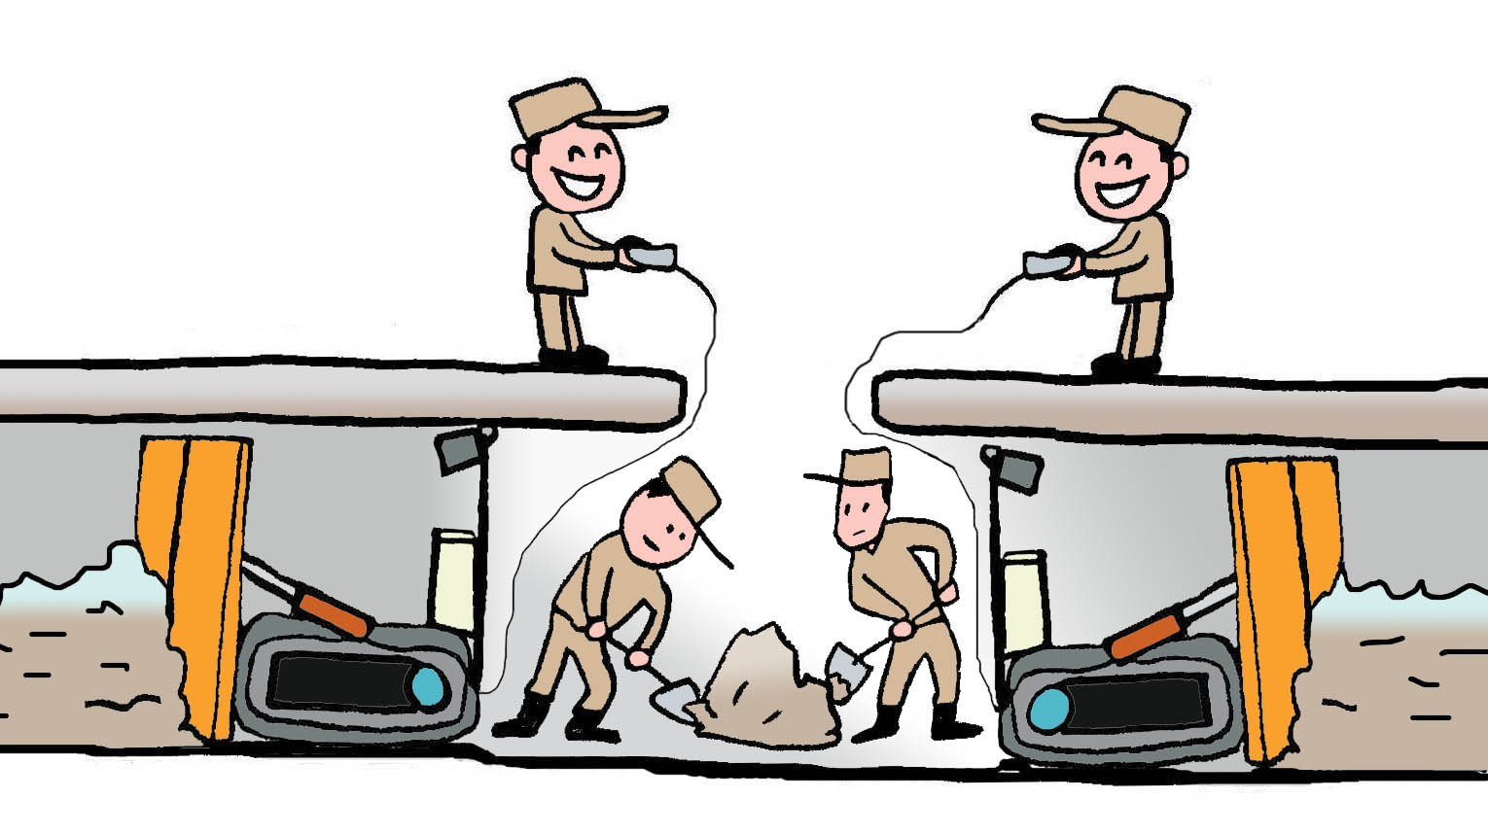
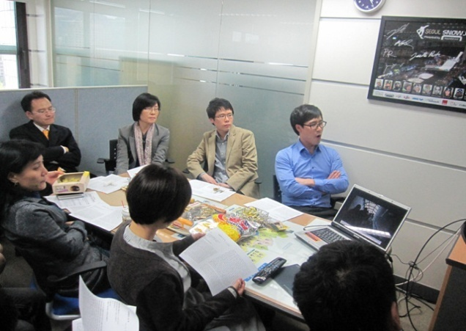
6. Creating a Creative Organization Culture
To Create a Passionate Organizational Culture :
“Creativity Learning Club”
Various forms including a metropolitan policy research club
under the dept head, a small-scale learning and research club
and an administrative service enhancement club - 36 clubs as of ‘07 → 399 as of ‘11(11-fold growth)
Aligning learning and work enhancement by forming clubs with various titles
Knowledge Club Case Presentation,
related contests etc.

Slide 30
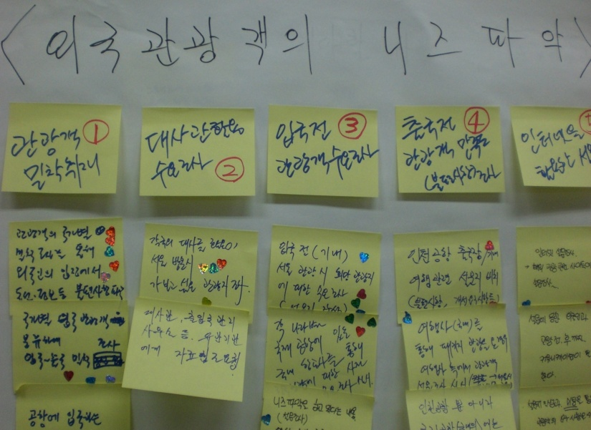
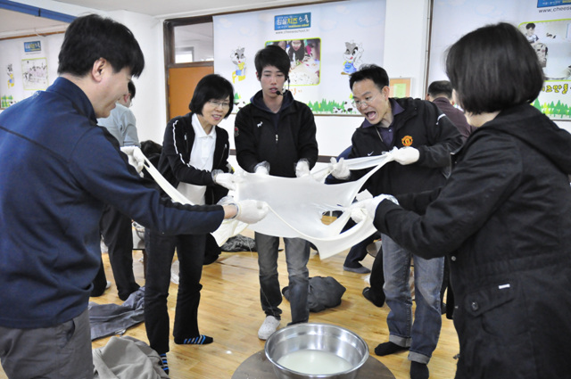
6. Creating a Creative Organization Culture
An Efficient Meeting Culture Generating an Open Organizational Culture : “Action Meeting”
“Action Meeting”
A type of meeting where prompt
decision-making and problem-solving are
possible based on free and open
discussions on pending issues

Slide 31
Ⅲ. Seoul is Changing
through Creative Administration
1. SMG Officials Changing
through Creative Administration
2. SMG’s Metropolitan Policies
to Change into National Policies
3. Future Steps of Creative Administration

Slide 32
1. SMG Officials Changing through Creative Administration
Generating Creativity Learning Environment
Transforming SMG Officials’ Mindset and Working Style
Thinking and working from citizens‘ perspectives
at all times
Entering into a learning systematization stage where
ideas are generated on one's own and work efficiency
is raised

Slide 33
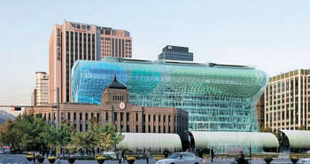
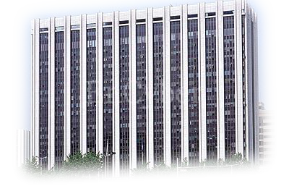
2. SMG’s Metropolitan Policies to Change into National Policies
Seoul
Korea
Long-term Lease Houses
Spreading Nationwide
Dong (ward) Integration
Restructuring Administrative Regions
SOS Project: Save Our Seoul
Low-carbon Green Growth
Promoting international exchanges of
outstanding technology & policies

Slide 34
3. Future Steps of Creative Administration
Seoul, a city with hope and vision where citizens are the master
Vision
Let’s create Seoul together ! Let’s enjoy Seoul together !
Create equal welfare opportunity
Build a strong economy for all
Experience creative cultures together
Create a safe, sustainable city
Provide
citizen-centered administration
Goals
Key words
Communi
cation
Citizen-oriented
Trust

Slide 35
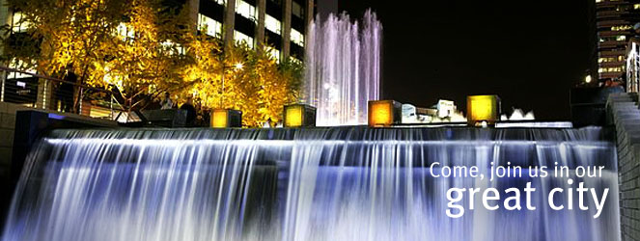
Thank You
| Vision and Creativity Promotion Division | 2012

